Slide 1
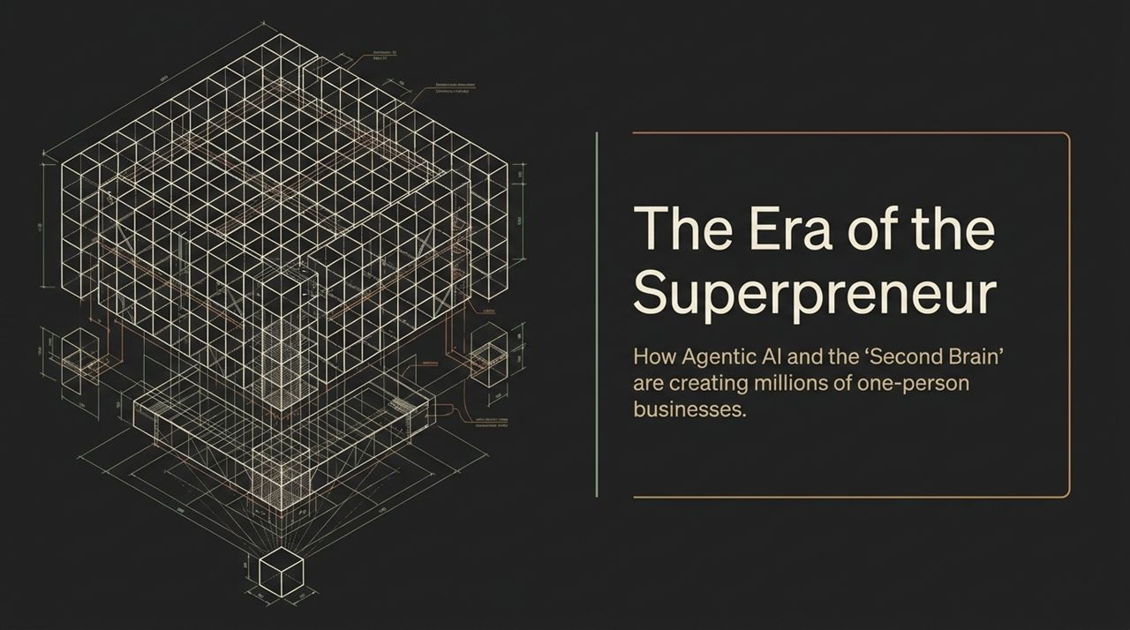
Notes:
Welcome, everyone. Today, we’re unpacking a massive paradigm shift in how value and software are created. We are officially entering the era of the Superpreneur—the AI-powered solo operator who can match the output, leverage, and memory of an entire traditional company.
To understand why this is happening right now, we have to look back at the timeline of AI interaction. In November 2022, we experienced the 'ChatGPT moment'. The core interaction model was simple: you typed in a prompt, and the model gave you an output. It had low-level reasoning and executed single-pass requests.
But around November 2023, a quiet revolution took place—what we call The Agentic Leap. Frontier models shifted from simple prompt-response loops to genuine reasoning, reflection, and self-correction. Instead of basic answers, you can now issue higher-order tasks. The AI can reflect, plan, execute multi-step workflows, and autonomously build complete end-to-end deliverables.
This shift from prompting to reasoning changes everything. It transforms AI from a passive assistant into an active partner, setting the stage for one-person companies operating at scale.
https://www.youtube.com/watch?v=zS0eTmgl5z4

Slide 2
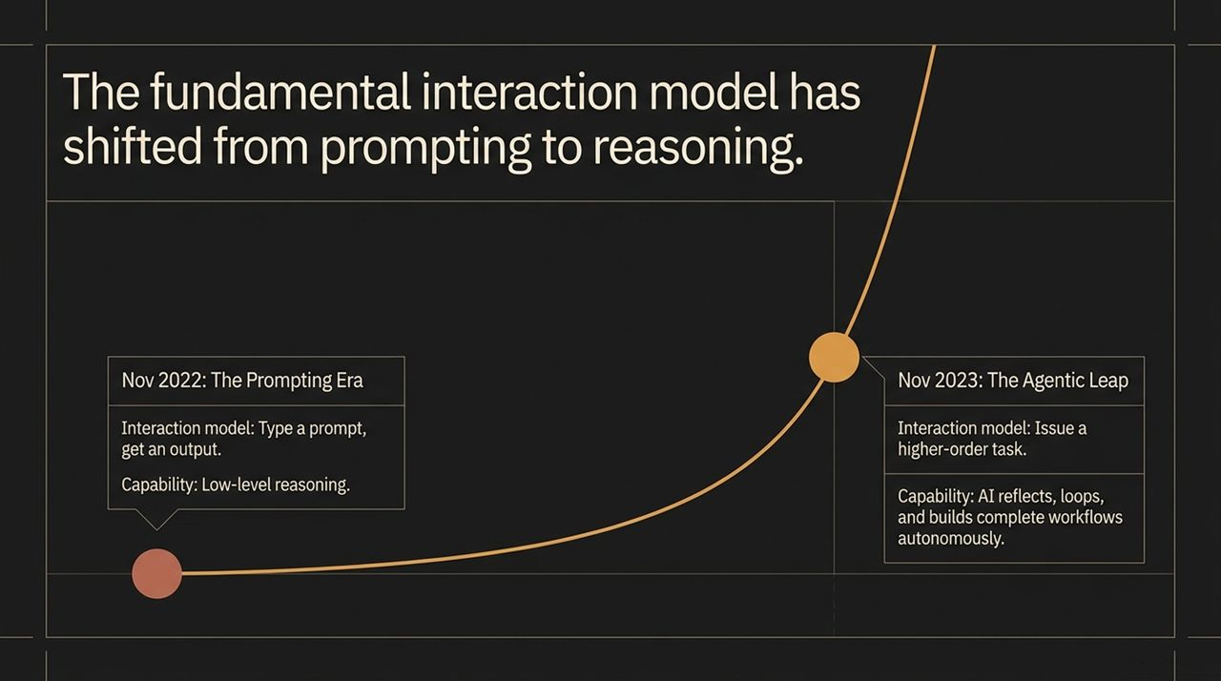
Notes:
Let’s look at the hard macro data driving this trend. Historically, there was a strict biological ceiling on a solo business. A single individual only had so many hours in a day and so much brain capacity to handle sales, marketing, support, and execution. To scale, you had to hire employees.
That biological ceiling has vanished. According to the U.S. Census Bureau, new business formations in the United States reached a historic record high, topping 5 million new registrations. But here is the most astonishing statistic: 86% of these newly registered companies have zero plans or statistical likelihood to hire a single employee.
They are intentionally designed as one-person operations leveraging AI to do the work that previously required entire departments. We are undergoing a fundamental economic transition: shifting from building companies of many to building AI-powered companies of one.

Slide 3
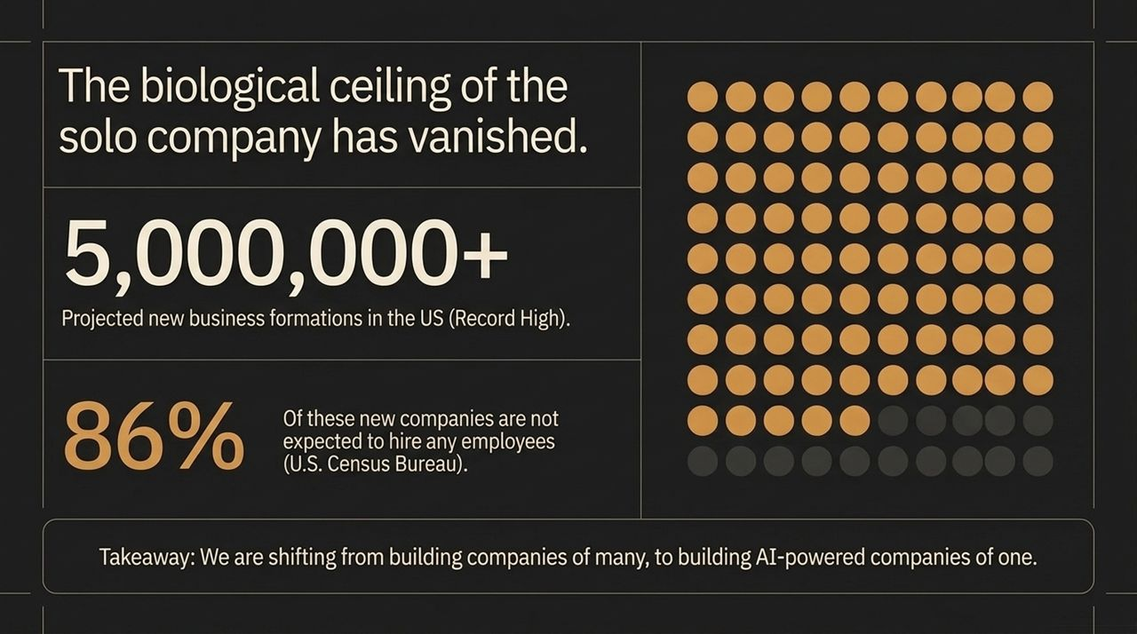
Notes:
To power a high-performing solo enterprise, we need to solve a fundamental paradox between human biology and current AI architecture. We call this The Intelligence & Memory Gap.
On the human side, our bottleneck is RAM Limit. Human brains are biologically amazing at deep reasoning, creative synthesis, and emotional intelligence. However, our short-term, working memory capacity is strictly limited. We cannot simultaneously hold thousands of emails, meeting transcripts, CRM notes, and social interactions in our working memory. Critical context constantly falls through the cracks.
On the flip side, look at the AI Core. Frontier models have massive IQs—they’ve read the entire internet. But their bottleneck is Time Freeze. A static LLM is frozen at the moment its training weights were set. Out of the box, it has zero persistent memory of your personal business, your customer interactions, your negotiations, or your strategic preferences.
The challenge is clear: humans have rich real-time context but limited memory bandwidth, while AI has massive intelligence but zero personal memory. Bridging this gap is the key to unlocking the Superpreneur.

Slide 4
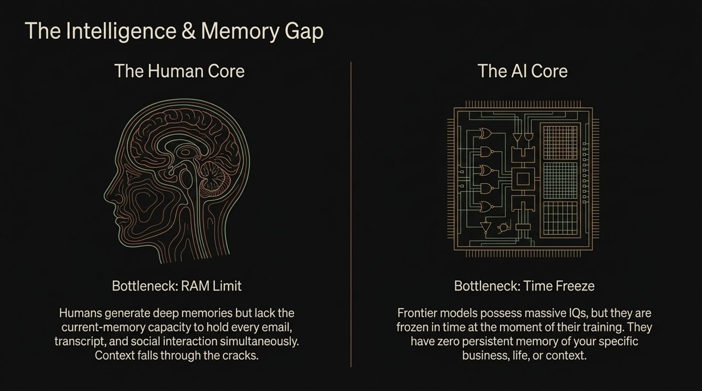
Notes:
The solution to this gap is The Second Brain. As Dharmesh Shah highlights, a Second Brain is a digital auxiliary system for the modern knowledge worker. It sits right at the intersection of your human context and the raw IQ of frontier AI models.
Here’s how it works:
The Power Boost: Instead of feeding generic prompts to an LLM, the Second Brain continuously supplements the AI model’s raw intelligence with your specific, persistent, personal context.
Continuous Ambient Learning: It operates silently in the background, ambiently capturing thousands of micro-interactions across your digital footprint—your emails, calendar events, meeting transcripts, LinkedIn messages, and social media comments.
The Result: The frontier model transitions from a generic chatbot into an all-knowing proactive business partner that possesses perfect recall of your entire operational universe.
Inspired by concepts like Andrej Karpathy’s 'LLM Wiki', this takes personal knowledge systems out of manual note-taking apps and turns them into a dynamic, living memory graph.

Slide 5
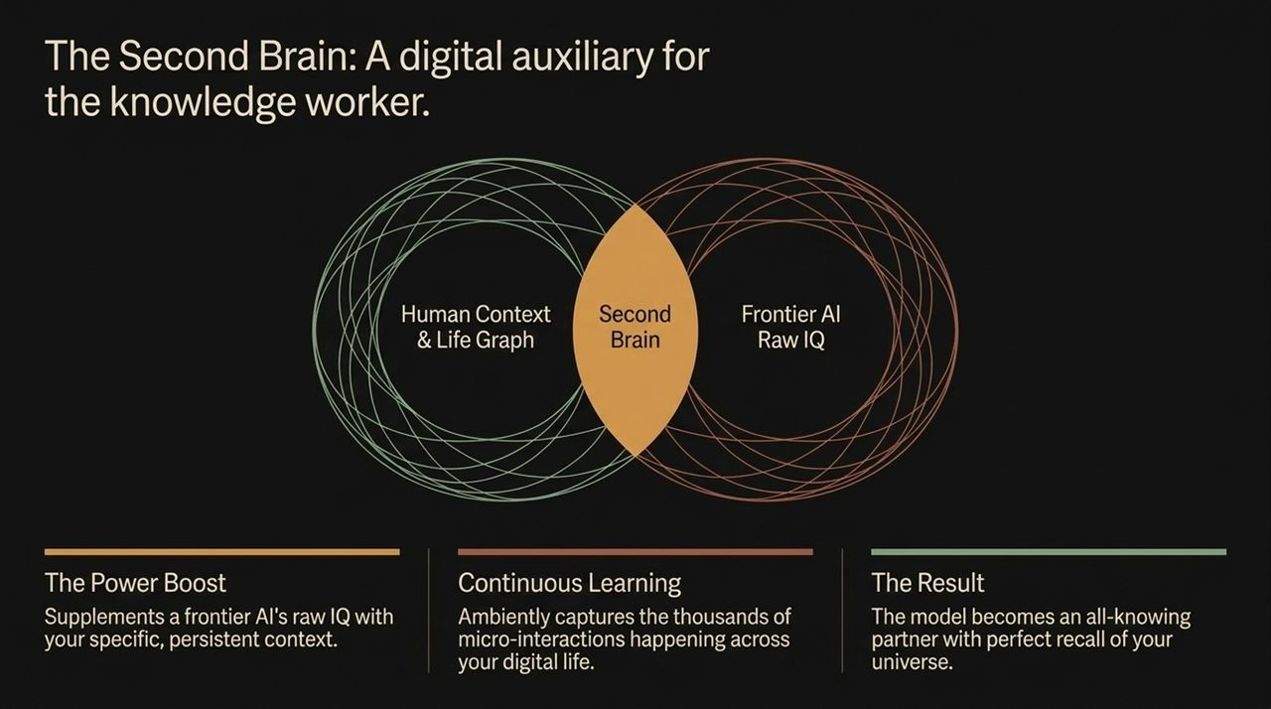
Notes:
To build practical AI applications, we must understand a crucial technical framing: The Model is the Engine; The Harness is the Car.
Frontier models like GPT, Claude, or Fable get all the media headlines. But the model is merely the engine. It provides raw horsepower, reasoning capability, and latent energy. However, an engine resting on a workbench will not take you down the highway.
The Agentic Harness is the car built around that engine. The harness provides the steering wheel, wheels, dashboard, brakes, and GPS. It captures the raw energy of the AI model and directs it safely and effectively toward a specific goal.
End-users don't interact with raw models directly—they interact with harnesses. The competitive moat in AI today isn't just training base models; it’s building highly specialized, domain-tailored harnesses that give models the tools, memory, and guardrails to execute complex work.

Slide 6
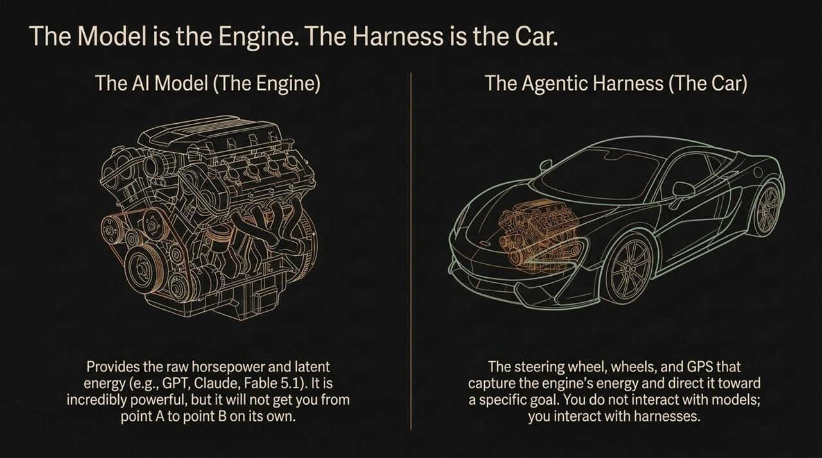
Notes:
When building a Second Brain harness, the underlying data architecture must be reimagined. Legacy systems rely on static files and hierarchical folder trees.
In contrast, the new primitive of data is The Object, not the File.
In a modern Second Brain architecture, every single data point is treated as a distinct, typed object connected via graph relationships:
An email received is an object.
A LinkedIn comment or Twitter like is an object.
A dropped negotiation, a meeting transcript segment, or even a user-stated preference—a 'Fact'—is an object.
By linking these objects dynamically in a knowledge graph, the AI can connect dots across disparate channels. It understands that a tweet from yesterday relates to an email sent three months ago and a meeting scheduled for tomorrow.

Slide 7
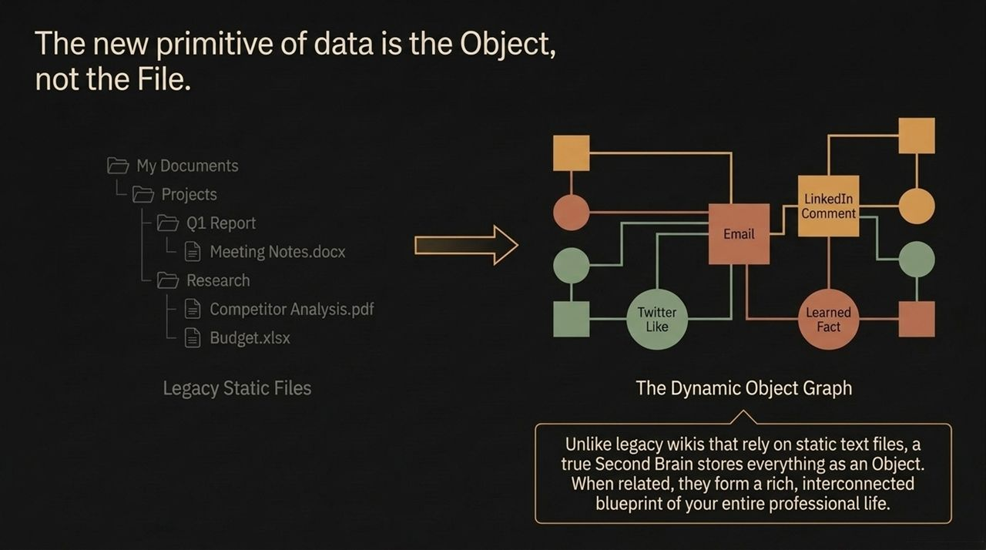
Notes:
This architectural shift leads to a major industry contrast between Legacy CRMs and AI-First Second Brain systems like Uspot.
Let's look at the core differences:
Core Architecture: Legacy CRMs are traditional database software with AI added on top as a feature or chatbot plugin. Uspot inverts this model completely—it is an AI Harness with a lightweight CRM built inside it.
Data Primitives: Legacy systems rely on static records like manual fields for name, address, and phone number. Second Brain CRMs rely on dynamic, interconnected objects—capturing everything from a YouTube comment to an inactive negotiation.
Input Mechanism: Legacy CRMs require tedious manual data entry and form filing. Uspot captures context ambiently and automatically across all connected digital channels.
Target User: Traditional enterprise CRMs require dedicated ops teams to configure and maintain. Uspot is purpose-built specifically for the solo Superpreneur.

Slide 8
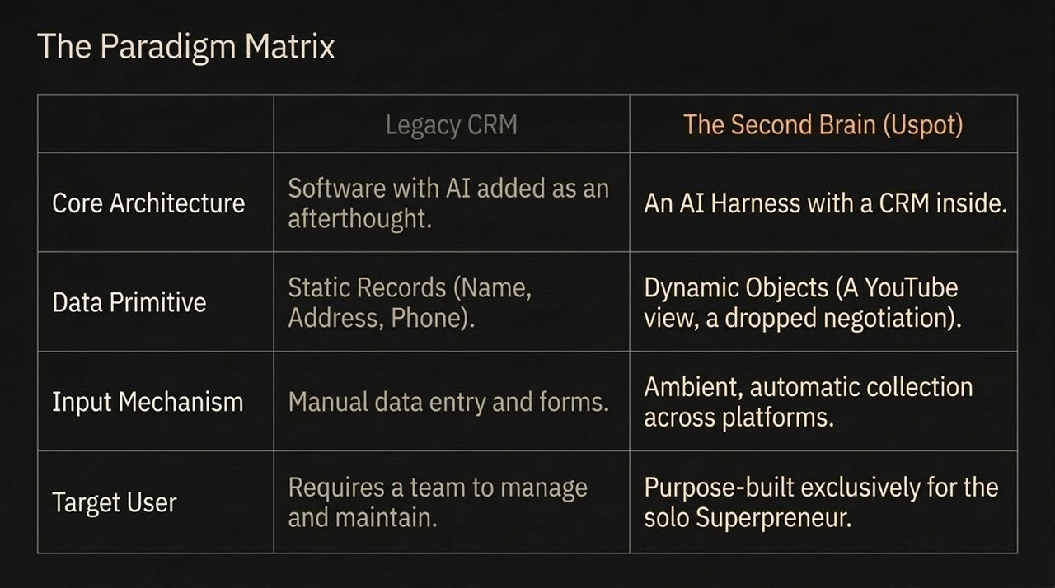
Notes:
Enter Uspot—a custom-built AI harness designed from the ground up for one-person companies.
Uspot combines three core elements into a single workspace:
Lightweight Natural Language Interface: You interact with your entire business graph simply by conversing with it, just as you would with ChatGPT or Claude.
Elimination of Operational Friction: It replaces static spreadsheets, sticky notes, and disconnected tools with a fluid, continuous conversation powered by personal memory.
Focused ICP Alignment: Uspot isn't trying to be a general consumer assistant or handle retail point-of-sale systems. It is optimized specifically for considered-purchase business relationships—consultants, solo software founders, creators, and advisors who rely on high-value networks and deep relationships to win business.

Slide 9
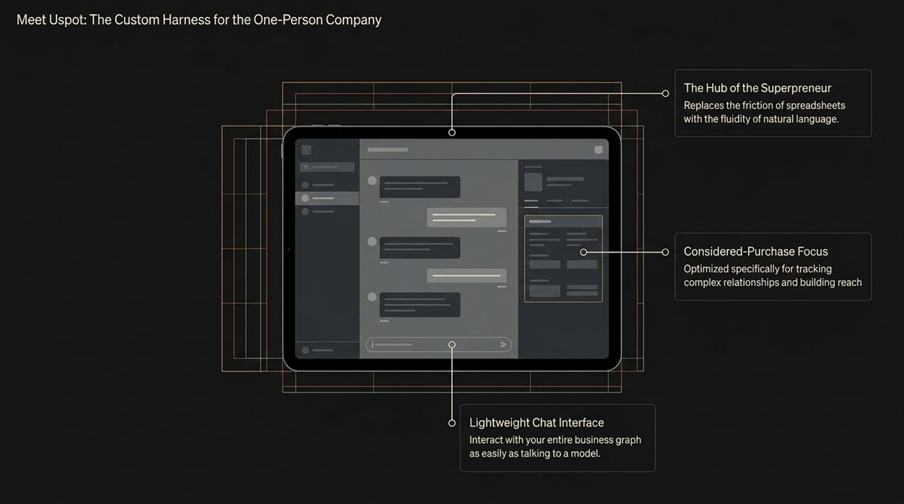
Notes:
One of the most important principles in the Superpreneur stack is Memory Portability.
Today, users suffer from severe AI FOMO (Fear Of Missing Out). Every week, a new frontier model drops—whether it's OpenAI, Anthropic Claude, or Google Gemini. But switching models usually means starting over from scratch, losing all the learned context and memory stored inside a proprietary model's memory tab.
You should own your memory; it should never be trapped inside a single AI vendor's silo.
Uspot decouples the memory layer from the underlying AI model using the Model Context Protocol (MCP). Your memory core lives independently. If a superior model comes out tomorrow, you can plug your Second Brain memory directly into that new model instantly. Your learned personal context stays with you forever.

Slide 10
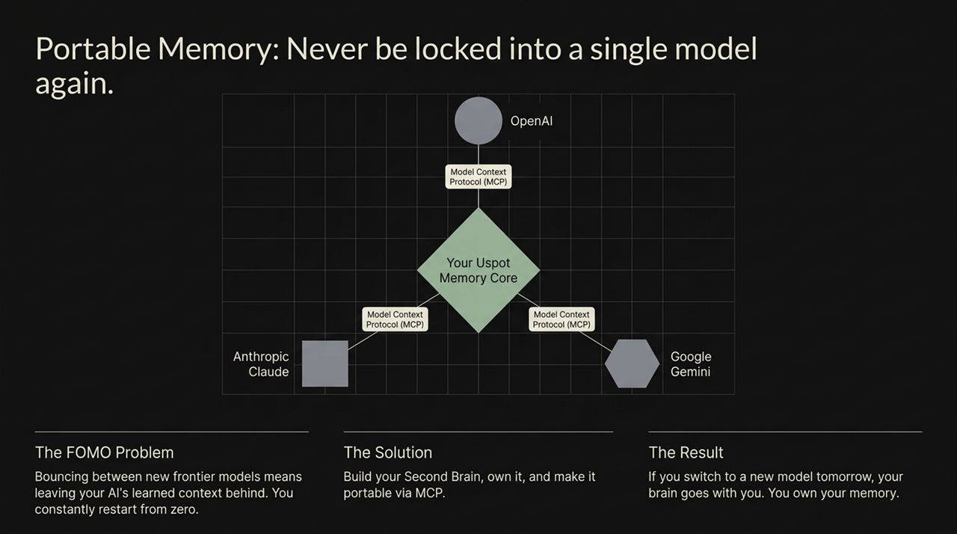
Notes:
Because Uspot maintains an active memory graph, it transforms from a reactive tool that waits for prompts into a proactive executive assistant that manages you.
Every morning, Superpreneurs receive an automated Executive Briefing highlighting actionable insights:
Proactive Opportunity: 'You dropped a domain negotiation 7 days ago. Our valuation tool estimates it is worth 3x the seller's asking price. Follow up today.'
Fact Updating via Feedback: If the AI suggests something irrelevant and you reply, 'I don't care about manufacturing domains,' the system immediately stores a new Fact Object: 'User does not want manufacturing opportunities.' Future briefings adapt instantly.
Network Monitoring: 'A key contact with 100k+ followers commented on your post yesterday. You haven't replied yet.'
This flips management on its head: instead of you constantly checking dashboards, the system proactively directs your focus to high-leverage activities.

Slide 11
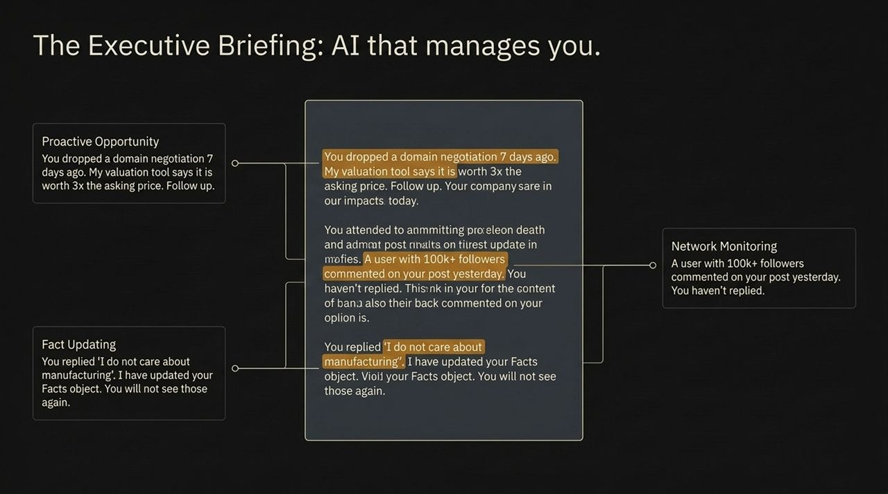
Notes:
To execute actions continuously without human intervention, the system deploys Cloud Agents.
Cloud agents are server-side background helpers that run 24/7 against your Second Brain graph. You program them using plain natural language instructions:
Listen: 'If someone mentions my brand on LinkedIn and the post reaches 20+ likes, send me an instant email alert.'
Scour: 'Read all my subscribed newsletters. If a mentioned company matches my ideal customer profile, create a prospect lead object automatically.'
Monitor: 'If internal emails mention Project Y, tag the message and text my phone immediately.'
These agents extend your leverage exponentialy, acting as digital staff members that monitor, filter, and execute tasks while you sleep.

Slide 12
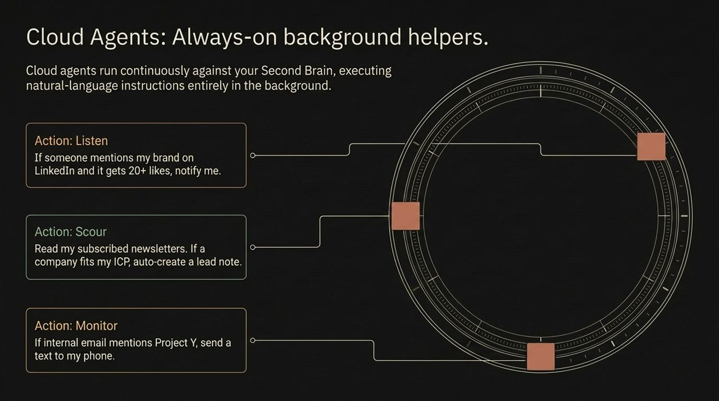
Notes:
Let's look at a concrete real-world example of how the Second Brain synthesizes data across disparate channels.
Imagine you want to find brand ambassadors or hire a key strategic partner:
Input: You simply type a goal in natural language: 'Find an ideal ambassador for our new product launch.'
Synthesis: The Second Brain cross-references multiple data streams simultaneously. It checks users who engaged with your past posts, analyzes your historical email threads, and reviews current LinkedIn career roles across your network.
Output: Rather than giving you a generic search result, Uspot generates a curated shortlist of top candidate matches and specifically identifies who in your immediate personal contact list can provide the warmest intro.
This turns unstructured, forgotten personal data into actionable strategic intelligence.

Slide 13
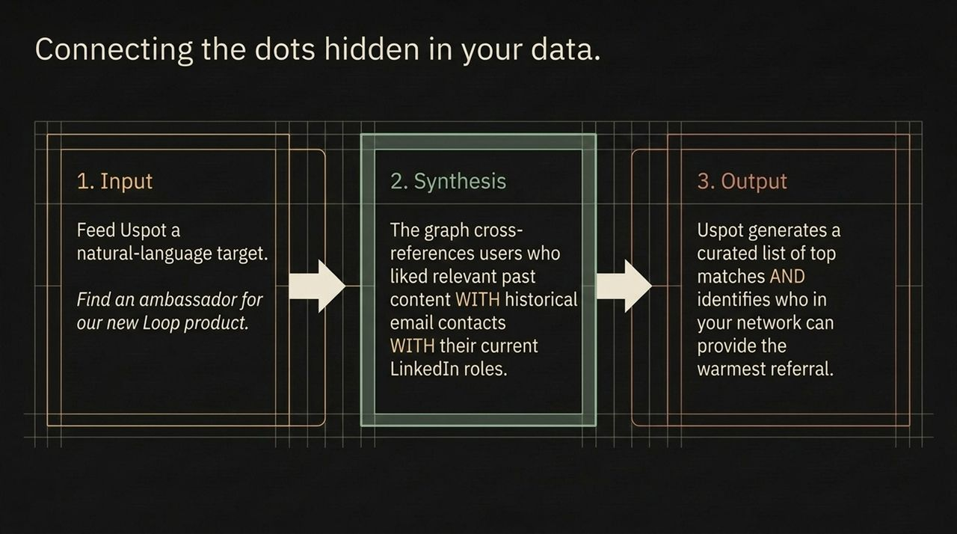
Notes:
Building software for one-person companies also requires innovating on business and monetization models. Traditional enterprise software relies on bloated annual contracts or seat-based subscriptions—which make no sense for a solo entrepreneur.
Uspot is testing a transparent consumption-based model:
Standard Tier: $10 per month, which covers base operational credits with pay-as-you-go scaling for power usage.
Community Promo: For listeners and early adopters, entering the promo code brain the green locks in a discounted rate of $7 per month.
This model aligns software costs directly with business value and usage, making enterprise-grade AI tools accessible to every solo operator globally.

Slide 14
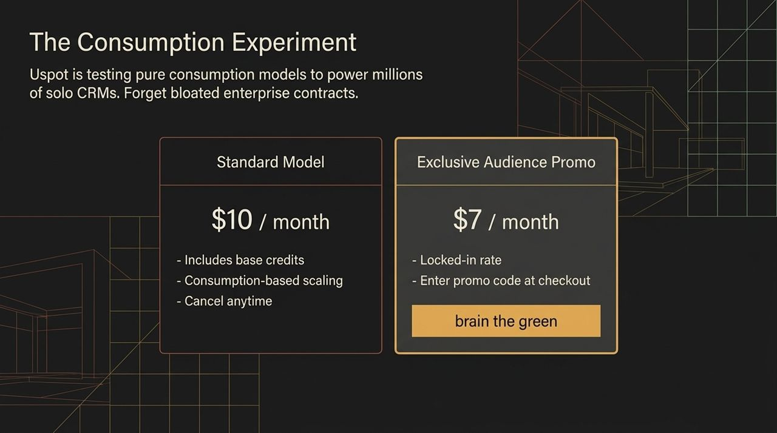
Notes:
To put this moment in historical perspective, think back twenty years. The original web boom allowed millions of small businesses to build online storefronts and reach a global market for the first time.
Today, Agentic AI and the Second Brain represent the ultimate democratization of leverage.
A single individual, operating with a Second Brain memory core and agentic cloud helpers, can now achieve the memory, reach, operational capacity, and market leverage of a 20-person enterprise. The traditional overhead required to run a business is disappearing, clearing the path for the Superpreneur era.

Slide 15
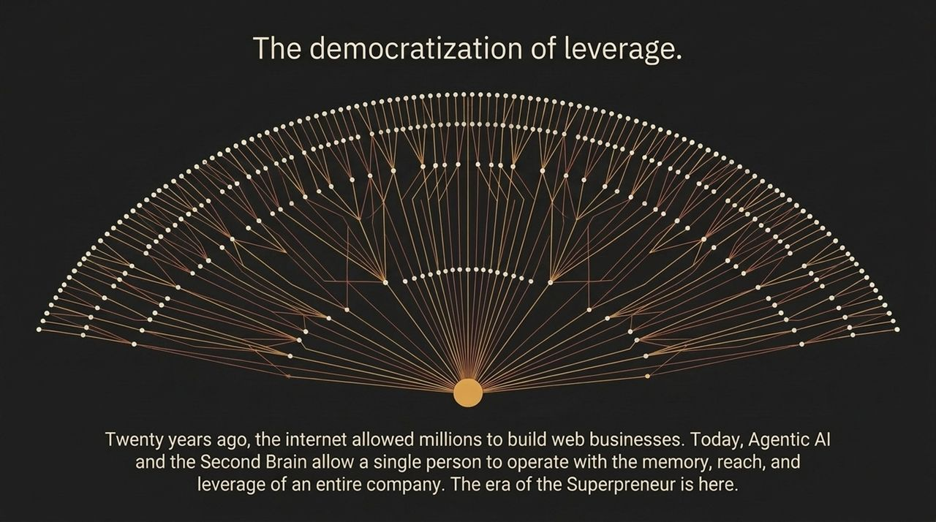
Notes:
Let's summarize the key strategic takeaways that define this transformation:
Engine vs. Harness: Understand that raw LLM horsepower is a commodity. True organizational capability comes from your personal harness—how well your tools steer AI models toward your goals.
Macro Solo Growth: 86% of new business formations are intentionally designed to remain employee-free. Solopreneurs are leveraging software agents instead of headcount.
The Superpreneur Skill Spectrum: Instead of siloing skills, a single entrepreneur now orchestrates creative design, marketing campaigns, data analysis, and product development simultaneously using agentic workflows.
By uniting intelligent engines with domain-specific harnesses, solo operators can scale outputs without scaling organizational complexity.

Slide 16
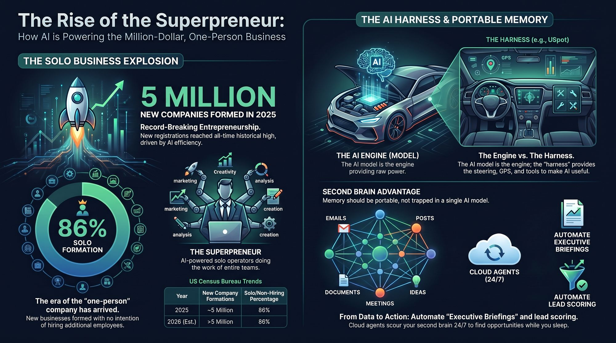
Notes:
To wrap up, let's look at the complete operational architecture from start to finish.
Unstructured data sits across your daily work life—emails, shared docs, meeting transcripts, social posts, and unorganized notes.
When ingested into a unified Second Brain Memory Core, always-on Cloud Agents operate continuously behind the scenes:
They automatically perform natural-language Lead Scoring based on your ideal buyer profile.
They continuously aggregate market feedback and network engagement.
They deliver proactive Executive Briefings every morning, keeping you focused on high-value business moves.
This is how we transition from drowning in data to executing high-leverage business actions. Thank you!
https://www.youtube.com/watch?v=zS0eTmgl5z4

